Slide 1
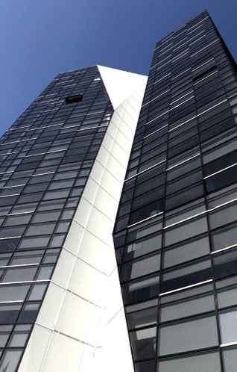
Georgia's Best Practice in Fight Against Corruption
Otar Kakhidze
11.06.2012

Slide 2
International Rankings
“Since 2003, Georgia has had unique success in fighting corruption in public services.
[It] destroys the myth that corruption is cultural and gives hope to reformers everywhere who aspire to clean up their public services.”
World Bank 2012

Slide 3
Global Corruption Barometer, 2010 – TI
Only 3% of Users Paid Bribe
77% of Citizens Perceive Gov’s Actions Toward the Fighting Corruption as EFFECTIVE
The Most EFFECTIVE Government in the Fight Against Corruption
Transparency International, 2010
78% of Citizens Think that Corruption Level DECREASED Significantly for the last 3 Years

Slide 4
Life in Transition Survey, EBRD 2010
2nd Place in Customer Service Efficiency
92% of Citizens are Satisfied with the Procedures of Official Documents Issuance
2010
78% OF CITIZENS AGREE THAT CORRUPTION HAS FALLEN IN THE LAST 4 YEARS, WHICH IS THE HIGHEST IN ALL THE SURVEYED COUNTRIES
Life in Transition Survey, EBRD 2010
2009
+33%
2008
2006
Corruption Perception among Citizens is the Lowest – 4%
Only 2% of Citizens Experienced Bribery

Slide 5
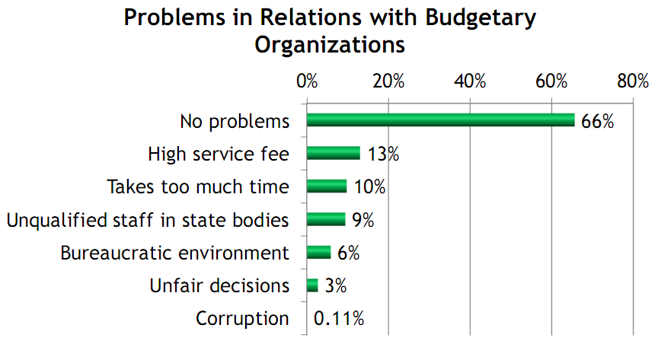
IFC Business Perception Survey 2012

Slide 6
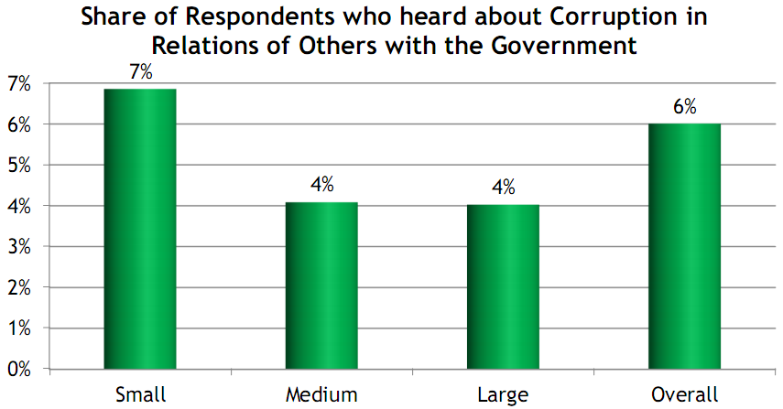
IFC Business Perception Survey 2012

Slide 7
Survey on Customs Clearance Procedures, IFC 2012

Slide 8
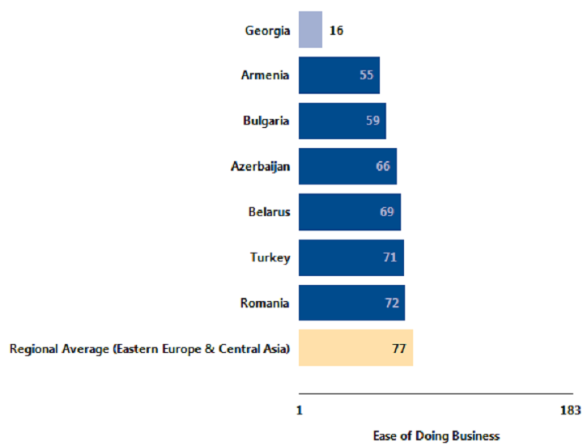
World Bank “Doing business 2012”
16th place
in Doing Business 2012
17th place
in Doing Business 2011

Slide 9
World Bank “Doing business 2012”
1 Procedure
2 Days
Registering property
1st Place
0.1% of property value

Slide 10
“Doing business 2012”: Registering property
Georgia
Denmark
Germany
Netherlands
5
5
1
4
40
7
2
16
Number of Procedures
Number of Days

Slide 11
World Bank “Doing business 2012”
9 Procedure
74 Days
Dealing with Construction permits
4th Place
20.2% of income

Slide 12
“Doing business 2012”: Construction permits
Georgia
Lithuania
Germany
Netherlands
9
15
9
15
97
176
74
142
Number of Procedures
Number of Days

Slide 13
World Bank “Doing business 2012”
2 Procedure
2 Days
Starting business
7th Place
4.3% of income

Slide 14
“Doing business 2012”: Starting business
Georgia
Japan
Germany
Netherlands
#1 REFORMER FOR THE LAST 5 YEARS
WORLD BANK, 2010
9
6
2
8
15
8
2
23
Number of Days
Number of Procedures

Slide 15
Ask Your Government! 6 Question Campaign, Law and Democracy Center, Canada
Accessibility of budget information
Georgia:
2nd place out of 80 states

Slide 16
Implementation of GRECO Recommendations
Amendments to the Criminal Code, September 2011
Legislative initiave on party financing, December 2011
Involvment of NGOs in drafting

Slide 17
HOW DID GEORGIA
ACHIEVE IT?

Slide 18
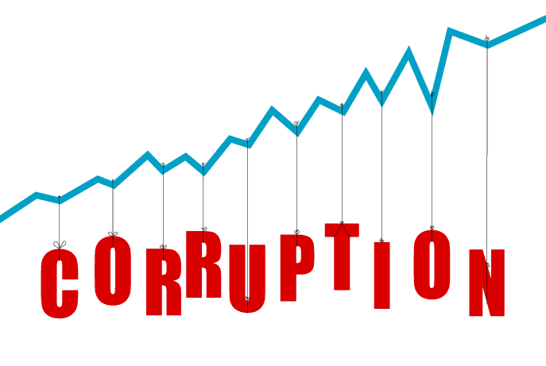
Anti Corruption Strategy
2003
Service Delivery Process
E-Governance
Prosecution of Corrupt Cases
2011
HR Policy
Amending Legislation
18

Slide 19
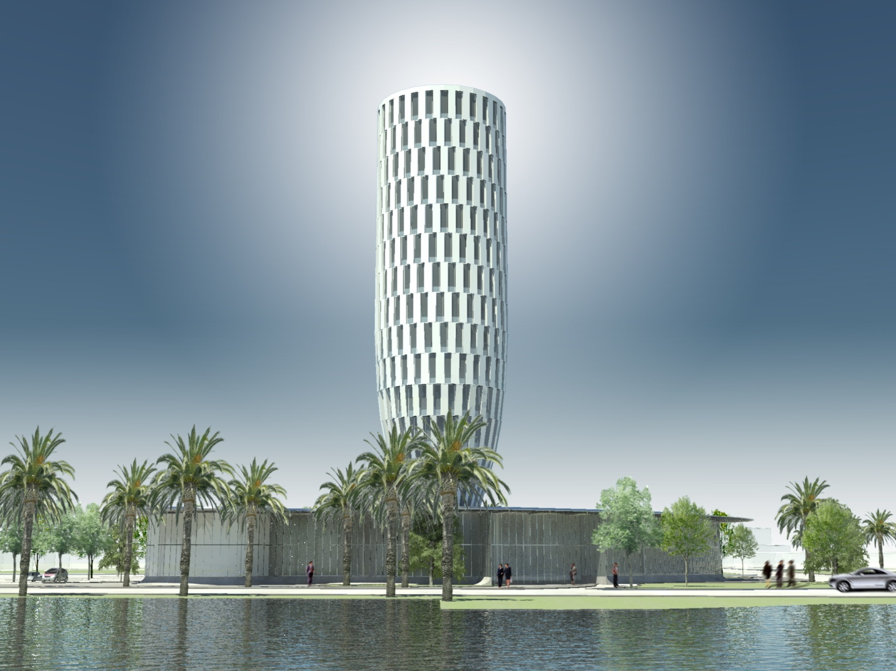
12 more PSHs by the end of 2013
Public Service Hall
National Bureau Enforcement
National Archive of Georgia
National Agency of Public Registry
Civil Registry Agency
Notary Chamber of Georgia

Slide 20
One-stop-shop Principle VS. Everything in One Space
New Concept of Service Delivery
Combination of different services into one space
Quick, Simplified and Customer-oriented Services
More than 250 Services in one space
Open, Transparent, Constant communication with customers…

Slide 21
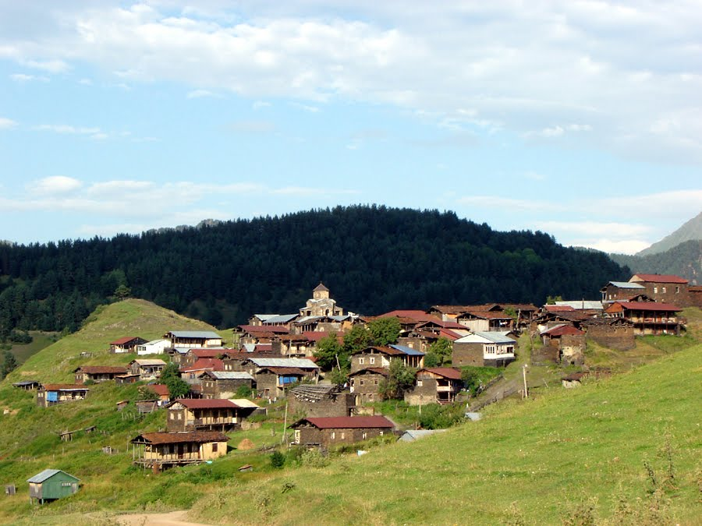
Public Service in the Rural Areas
Village Development Centres

Slide 22
HR Policy
Personnel Optimization
Since 2005 Personnel Selection on the basis of Competitions
Tests
Tests
New System of Tests & Trainings
Promotion
Tests
New System of Motivation (monetary, non-monetary)
Appointment
Personnel Database
Training

Slide 23
HR Policy
Salary Raise
Improved Working Conditions
400 – 500 $
2010
Transparent Recruitment & Assessment System
2006
Career Map
2004
2000
15 – 60 $
Financial Disclosure
23

Slide 24
Liberalization of Economy
Licenses
Permits
300
600
86
50
Construction Permit
7th Place

Slide 25
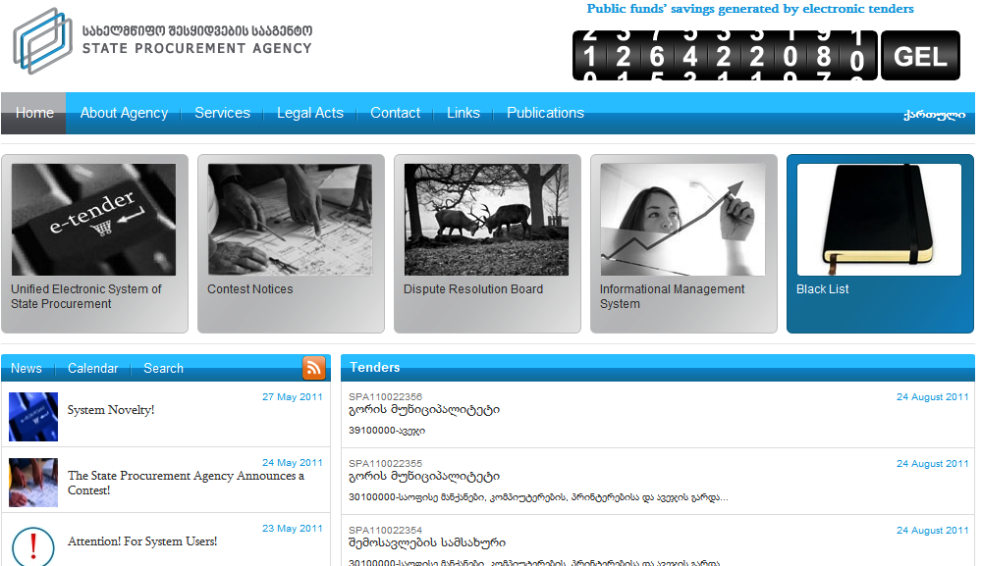
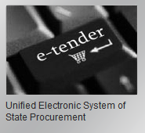
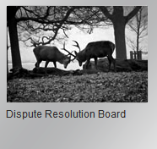
E-State Procurement System
Transparent & Competitive Procurement Process
Appr. 33 654 tenders announced
As a result 202 100 670 mln GEL (13.8 %) saved
Establishment of Dispute Resolution Board
25

Slide 26
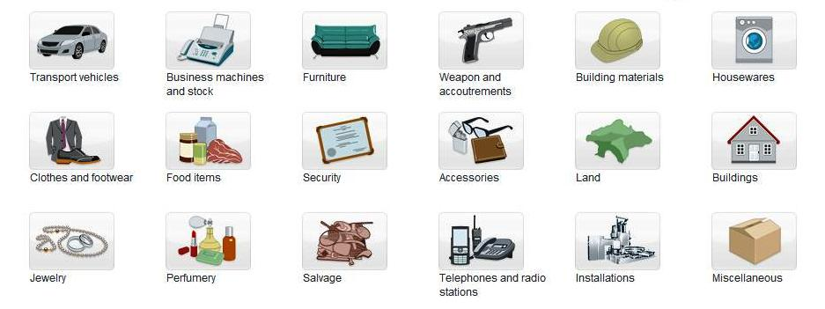
E-Auction

Slide 27
Successful Tax Reform
Tax Reform
District tax officer
Personal tax Agent
Alternative Audit
Customs Clearance Zone
Automated risk-management system
Mediation Process
New Tax Code
Tax Ombudsman

Slide 28
Electronic Program for Budgeting/State Treasury Electronic System
E-based exchange of information
Ministry of internal affairs
Administration of the President
Ministry of Justice
Automated stages of budget planning
ფინანსთა სამინისტო
Ministry of education and science
Other institutions

Slide 29
Online Asset Declaration
Financial Disclosure
WWW.DECLARATION.GE
29
29

Slide 30
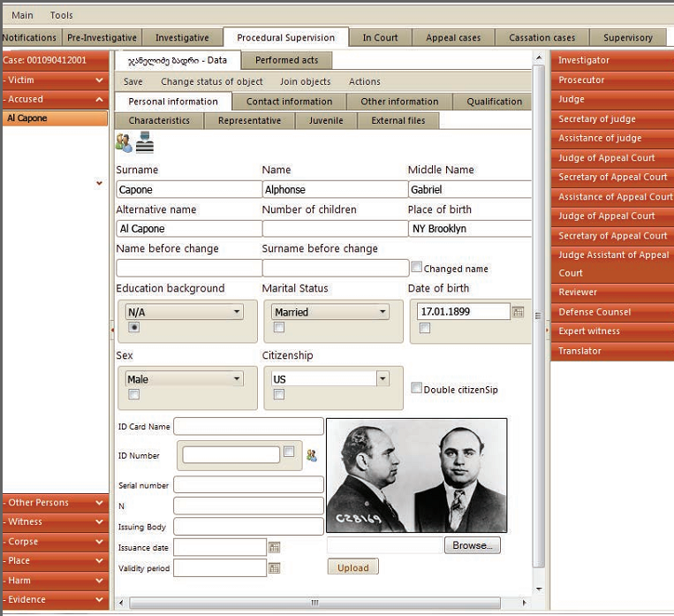
Integrated Criminal Case Management System (ICCMS)

Slide 31
Breakthrough Possibilities for Citizen Engagement:
Citizen’s Engagement in the Legislative Process
www.matsne.gov.ge
Pro-active Disclosure www.data.gov.ge
Citizens’ ideas/discussions- www.ichange.ge
E-petitions – www.petition.gov.ge

Slide 32
Thank You

